Slide 1
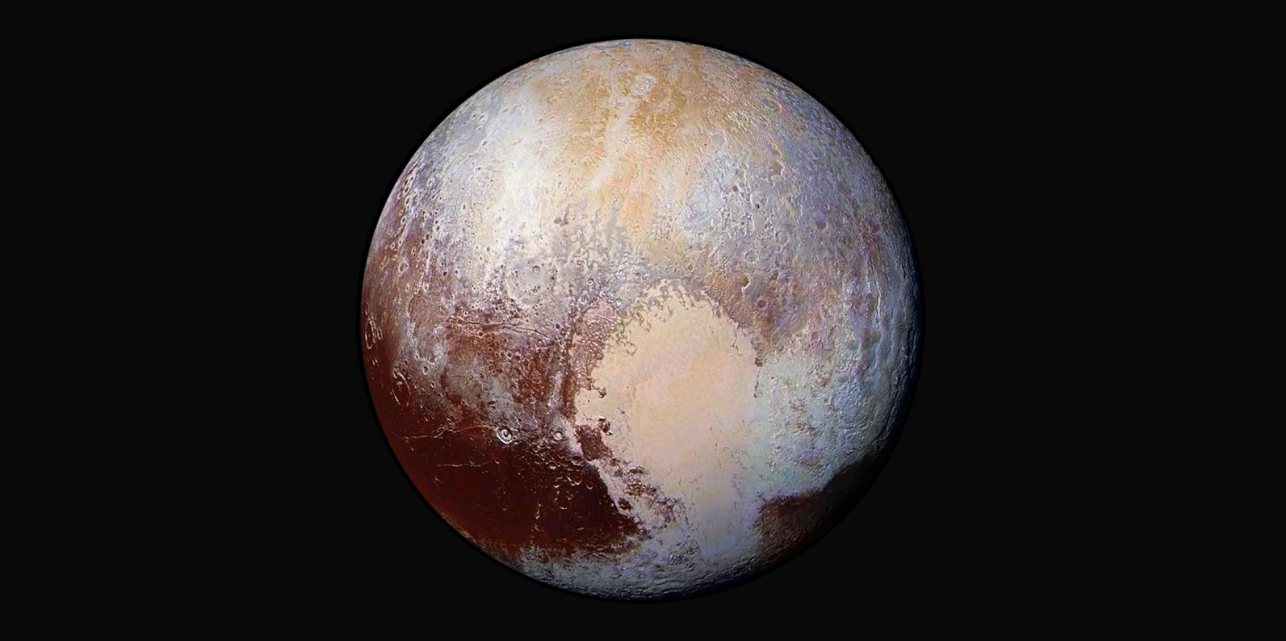
JVSRP Final Presentation
Lorenzo Feruglio, PhD student, Politecnico di Torino
Mentors: Alessandra Babuscia, Kar-Ming Cheung
332-H
Notes:
Good morning everyone, I’m Lorenzo Feruglio and this is the presentation that concludes my Visiting Student Research program here at JPL. Before beginning, I would like to thank Alessandra and Kar-Ming for giving me the opportunity to come here for this period.

Slide 2
Outline
Introduction & about me
Main research project
Interplanetary CubeSat Asteroid Mission
Preliminary Design for an Interplanetary CubeSat Mission
Payload Data Selection and event recognition
Failure detection
Secondary projects:
Inflatable Antenna
Small Satellite Mission Database
Notes:
This is the outline of the presentation: I would like to start by introducing myself and my background as a PhD student, in order to better understand why I’ve chosen certain objectives for my permanence here.
Continuing, I will describe the main project I have worked on, an Interplanetary CubeSat Asteroid Mission, especially going into the details of three aspects I’ve taken care of, all related to the field of Mission Autonomy: automating the preliminary design for a CubeSat mission, the autonomous selection of payload data, and the autonomous failure detection.
Lastly, two brief slides will describe the two secondary project I mainly worked on, the Inflatable Antenna and the Small Satellite Mission Database.

Slide 3
Introduction
About me
PhD student, Aerospace Engineering
Background: Systems Engineering
Field of research: Small Satellite Mission Autonomy
Current year tasks objectives: explore and realize prototypes to evaluate the behavior and performances of the most promising Artificial Intelligence algorithms for a space mission
The research carried on at JPL reflects the current tasks objectives
Three directions have been followed:
Tradespace exploration with genetic algorithms
Payload data selection and event recognition with neural networks
Failure detection using fuzzy logics
Notes:
I’ll talk now briefly about me and my background: I’m a space system engineer, and currently researching in the field of mission autonomy applied to small satellites.
The period here at JPL fell during my second year of PhD (out of three) and the objectives for the second year were to explore and realize prototypes to evaluate the most promising artificial intelligence algorithms to be applied during all the phases of a space mission.
This has been done in the idea of developing a methodology (during my third year) for the design of small satellites with enhanced autonomy.
In particular, in these 5 months I’ve explored three technologies: Genetic Algorithms (and I’ve applied them to a tradespace exploration problem, as we’ll see)
Neural Networks (for payload data selection and event recognition)
Fuzzy Logics (for failure detection)

Slide 4
COPINS
Cubesat Opportunity Payload Intersatellite Network Sensors
Notes:
Now I’m going to talk about the reference mission to which I’ve focused my research, and this is called COPINS – CubeSat Opportunity Payload Intersatellite Network Sensors.
This is a cubesat mission, thought especially to demonstrate the capability of performing distributed science, in this way taking the distances from traditional monolithic spacecrafts.

Slide 5
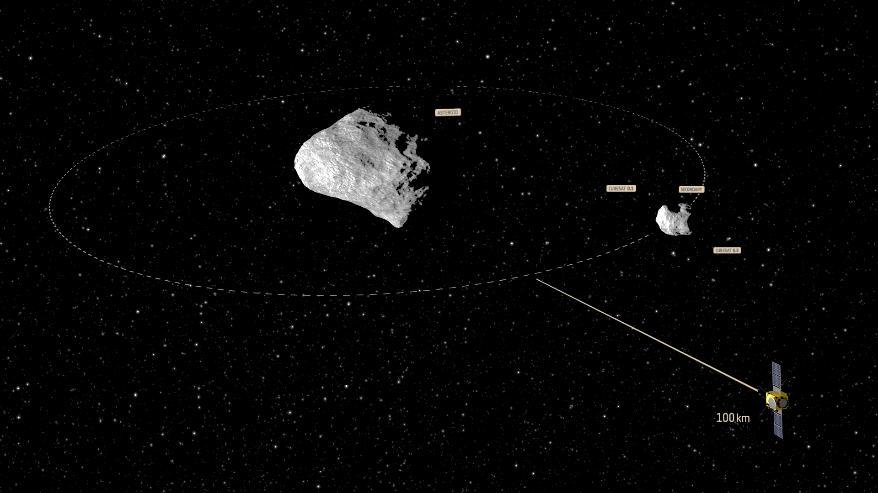
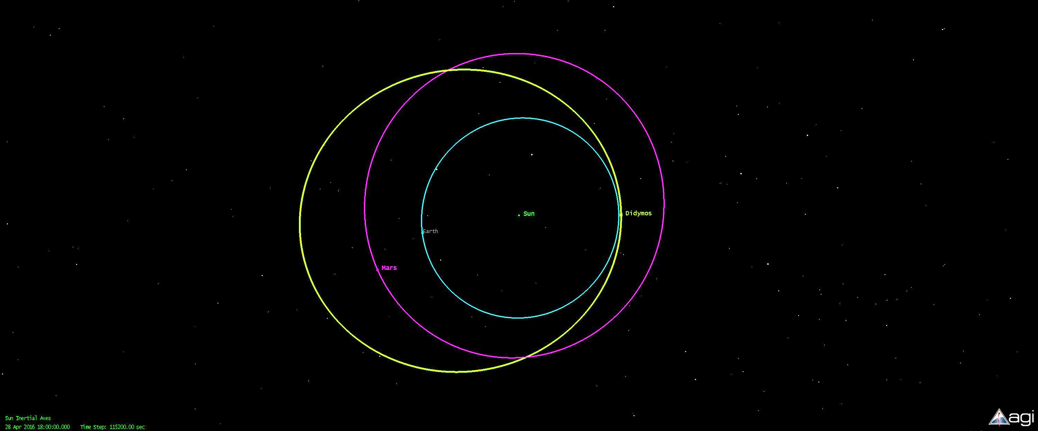
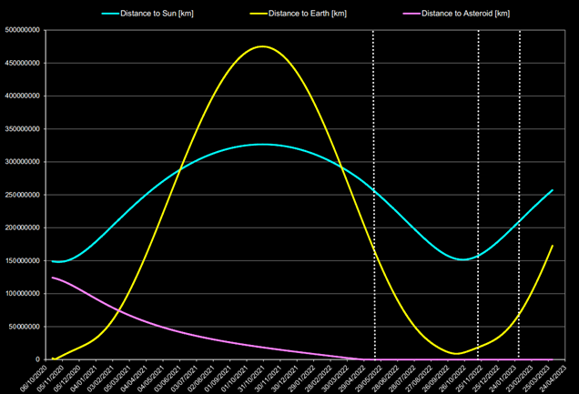
Context
Reference mission
Didymos system
Apollo group
Binary asteroid (diameters: 800m primary, 150m secondary)
Selected as target for the AIDA mission:
DART: impactor spacecraft (NASA)
AIM: monitoring spacecraft (ESA) (A/B1 kickoff: March 2015)
Objectives:
Asteroid deflection, asteroid characterization
AIM Payload:
Two 3U CubeSats (30x10x10cm)
Support to AIM, increase science return, technology demonstration
Notes:
Before we go into details, I would like to provide a bit of context for the mission.
The mission will take place at Didymos binary system, an apollo asteroid (it’s perihelion is close to sun wrt earth, and it’s aphelion is farther wrt mars). The two bodies are fairly small (800m diameter for the main, 150 diameter for the secondary). This asteroid is the easiest Near Earth Asteroid to reach in terms of dV. A joint effort between NASA and ESA will provide two spacecrafts that are scheduled to launch in 2020. The main objectives of the joint mission are an asteroid redirection experiment and asteroid characterization. Mission objectives of the ESA spacecraft (AIM) are to characterize the asteroid, both the physical properties and its motion in space, and NASA objectives are to impact the secondary asteroid in order to deflect it, and change its orbit with respect to the primary. ESA spacecraft will have to monitor and assess the orbit change.
In addition, ESA spacecraft will carry two 3U CubeSats, that will be released in situ. Their mission objectives are to provide support to the main spacecraft, possibly increasing the science return of the mission, and/or perform technological demonstrations.
The images that you can see in this slide depict what I’ve just described. The last image show the distances of AIM spacecraft wrt Earth (Yellow), Asteroid (pink) and sun (blue). The three vertical white lines show the two intervals for the main mission, and the foreseen extension period.

Slide 6
Objectives of the collaboration
Analysis of mission concepts, focusing on CubeSats as secondary payload
Review of literature
Analysis of mission scenarios
Communication architectures
Design budgets
mass, power, link, propulsion, cost budgets
Selection of a mission concept
Open source
Notes:
Now that I have provided a bit of context, these were the objectives of my collaboration here at JPL: to analyze one or more mission concepts for the CubeSat mission, analyzing the mission scenario, the communication architecture, design budgets and making a work all based on open source data.

Slide 7
Initial Considerations
Flexible environment:
Growing selection of components
COTS are the main option
Increasing availability of space qualified components
Stakeholder needs are also TBD
Increased science return, technological demonstration
Open for proposal
Uncertainties:
What is the budget for the CubeSats?
How do we pick a mission concept?
How much can we push the limits on the system capabilities?
Which components do we use?
How do we decide on mission-level trade-offs?
How good will the chosen design satisfy the stakeholders?
Notes:
I would like to introduce the thought process I’ve made, when I first started to analyze this problem. Two facts were clear from the beginning: CubeSats are a growing reality, and the availability on the market of COTS components is increasing rapidly. Space qualified components are also appearing on the market. Secondly, stakeholder needs were defined to the very high level, but they weren’t tracing down to a defined science traceability matrix. It was open for us to decide that, as this is a call for proposal.
Nonetheless, the uncertainties were even more clear: we didn’t have a budget, we had to pick a mission concept but it was unclear how much we could push on the system capabilities, let alone the selection of components and the decisions on the architecture and mission operations that would satisfy the stakeholders the most.

Slide 8
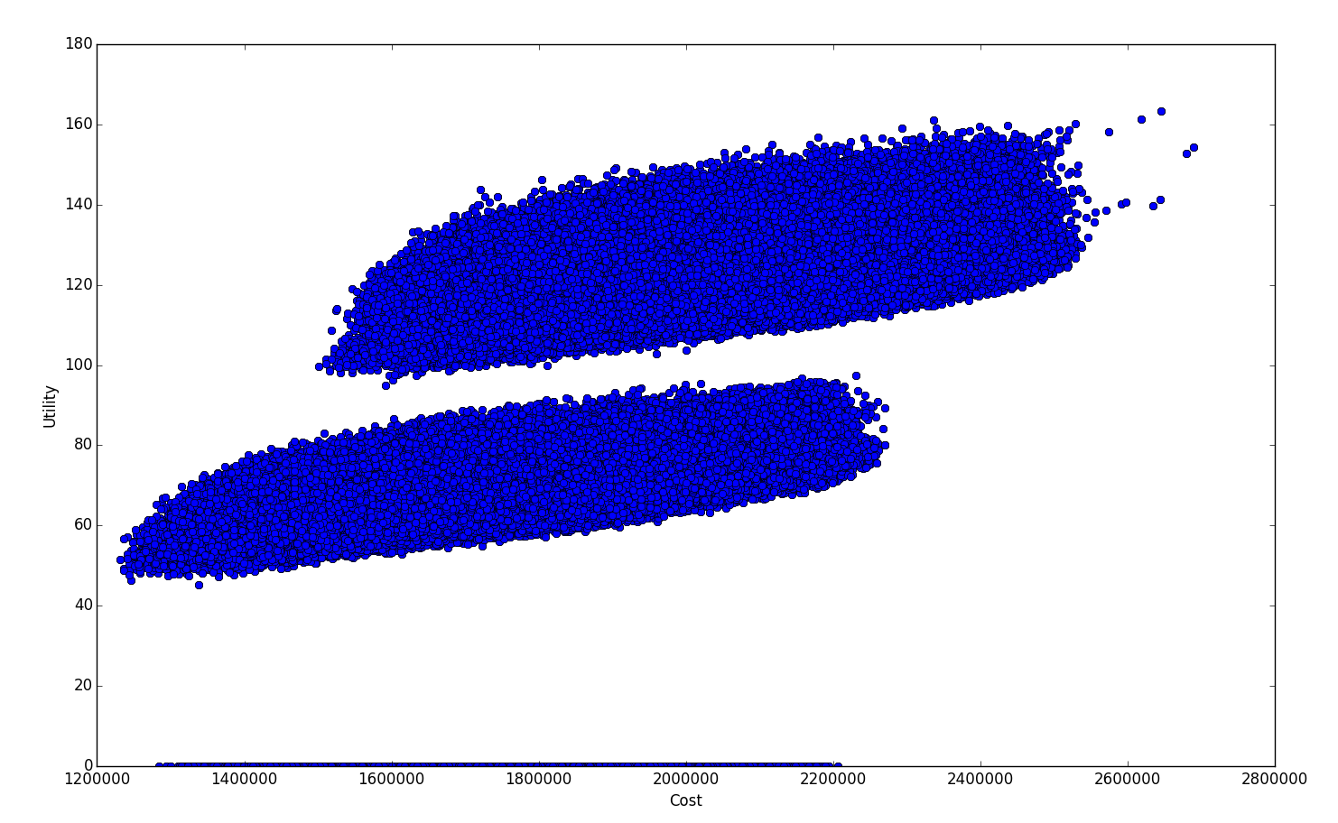
Tradespace Exploration Problem I
Can we analyze this as a tradespace exploration problem?
Design vectors
Notes:
All in all, this looked like a perfect setup for tradespace exploration.
Let’s have a look on what are the fundamentals of trade space exploration theory.
What you see here is the a typical solution space for the multi attribute utility theory analysis. In this type of theory, the idea is to evaluate a great number of solutions with respect to a given parameter (Usually cost, but it can be mass too, for example). The parameter to with we rank the solution is usually the utility, that is an indicator of how much a given solution satisfies the stakeholders. As you can see from the picture, the red line identifies a front (called the pareto front) of all the optimal solutions, given a certain cost.
In the next slides we will see how I setup this problem.

Slide 9
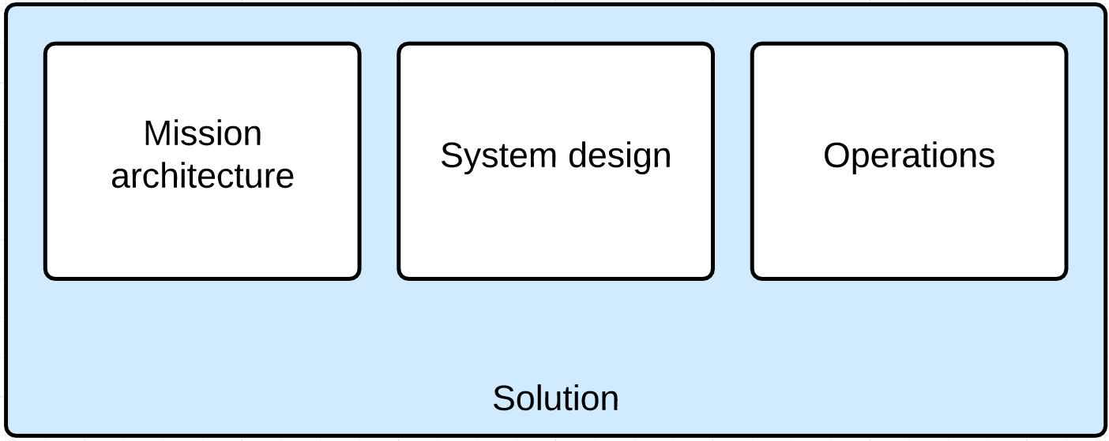
Tradespace Exploration Problem II
Can we analyze this as a tradespace exploration problem?
Solutions characteristics
As close as possible to a full mission concept
Mission architecture, operations and system aspects
Notes:
So, firstly, if we want to construct a sets of solutions to solve our mission design problem, each solution has to be as close as possible to a full mission concept. This means that aspects from mission architecture, operations and system design shall be included.

Slide 10
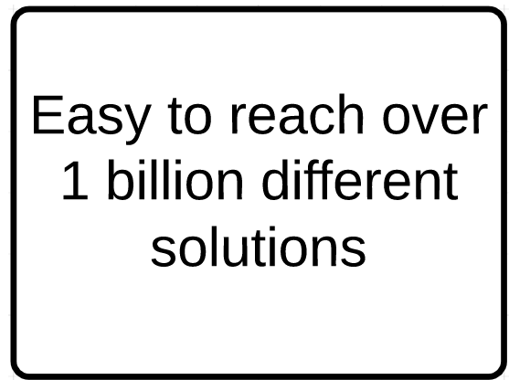
Tradespace Exploration Problem II
Can we analyze this as a tradespace exploration problem?
Solutions characteristics
As close as possible to a full mission concept
Mission architecture, operations and system aspects
Computational problem
More details bring more variables
Design vector explodes quickly
CubeSats database
Multitude of components available
Unfeasible to evaluate all the possible designs
Notes:
It’s easy to see how this can lead very soon to a computational problem: including a whole mission concept in the solution, and given the great number of COTS components that can be taken into consideration, the design vector that describes our mission concept grows big very fast. Also, all these options make the solution space inflate quickly too.

Slide 11
Tradespace Exploration Problem II
Can we analyze this as a tradespace exploration problem?
Solutions characteristics
As close as possible to a full mission concept
Mission architecture, operations and system aspects
Computational problem
More details bring more variables
Design vector explodes quickly
CubeSats database
Multitude of components available
Unfeasible to evaluate all the possible designs
Concurrent Design is needed
Can we create an algorithm for concurrent design as a result of the tradespace exploration?
Notes:
So at the end of this initial considerations I started to wonder if it was possible to build a tool, an algorithm, that would emulate the work done during a concurrent design session. The following slides will show how I proceeded to construct the algorithm in the attempt to do that.

Slide 12
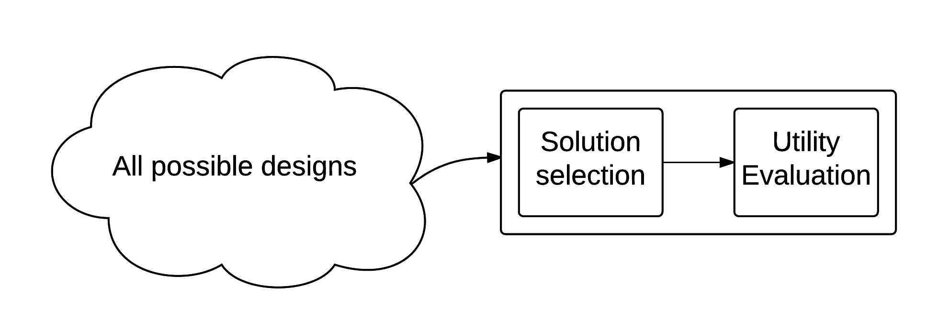
Tradespace Exploration Problem III
Basic setup
Notes:
As we can see in this slide, this is the basic setup for the multi attribute utility theory. An algorithm will simply evaluate the utility of all the solutions, exploring them all (with awful performances, and great limitations on the size of the design vector).

Slide 13
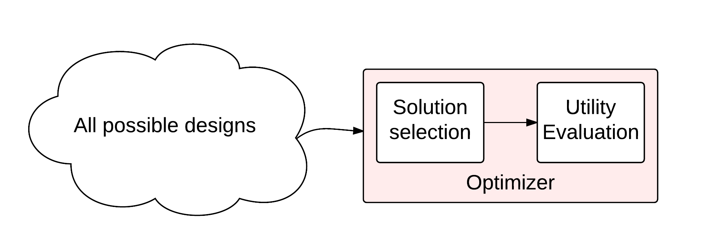
Tradespace Exploration Problem III
For problems with a great amount of solutions, we add an optimizer
Notes:
What is it done usually, is that an optimizer is added to the system, that takes care of intelligently selecting only the most promising solutions. This is especially useful when the design vector contains a great number of variables.

Slide 14
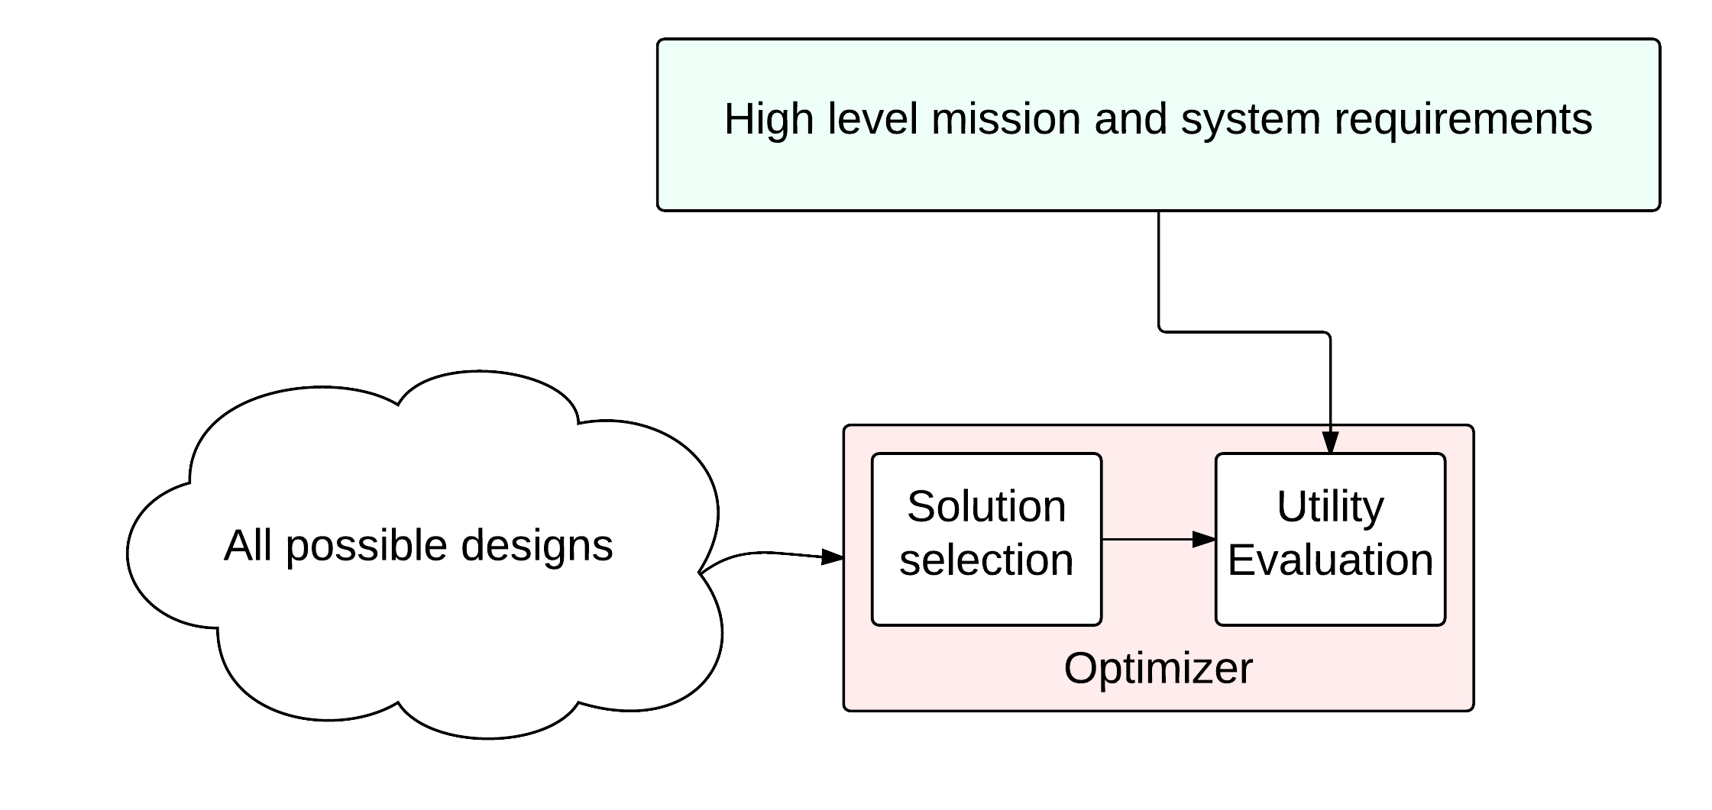
Tradespace Exploration Problem III
Can we consider the mission and system requirements when evaluating a solution?
Notes:
But then I wondered, can we design a way to verify high level mission and system requirements when we evaluate the solutions? Can we integrate it with common used tools, like DOORS for requirements management? This will allow to select only the solutions that verify all the top level requirements, and discard the others.

Slide 15
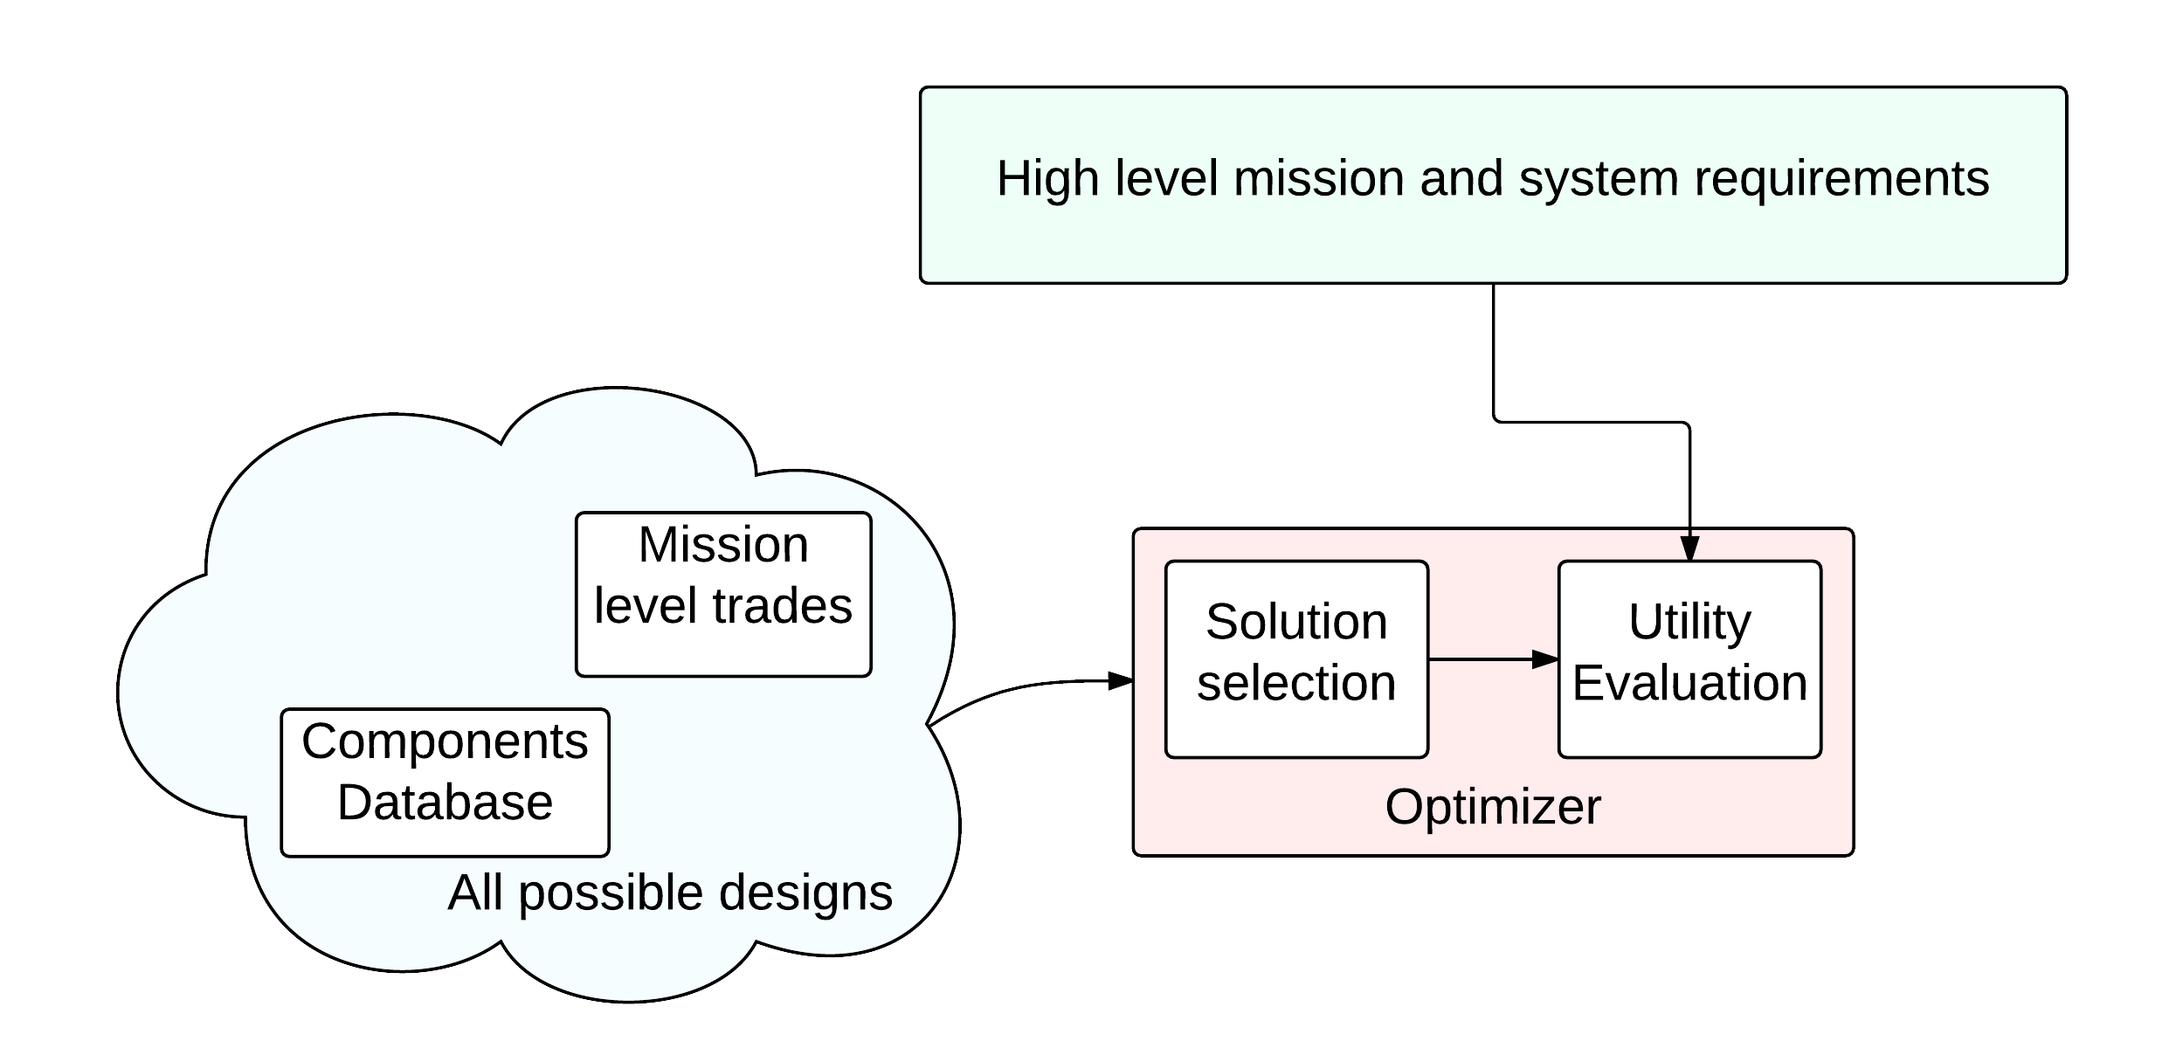
Tradespace Exploration Problem III
Use a database from where to choose solution components
Notes:
Then I though... CubeSats have a great amount of components available on the market.. Can we find a way to have our solutions built by picking also items from the database? This will provide powerful tools for more detailed designs, as we will see later.

Slide 16
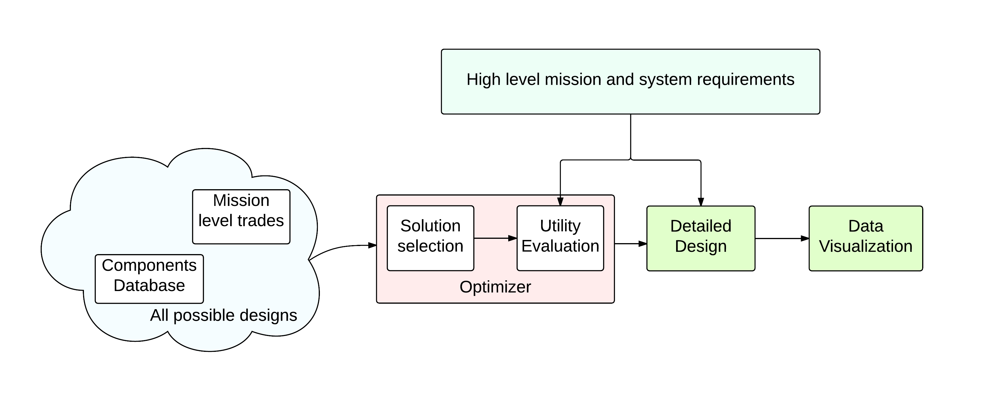
Tradespace Exploration Problem III
Adding system budgets and data visualization to the algorithm
Notes:
In the end, this is the architecture of the tool I’ve built: once the algorithm for the solution optimization has finished, the selected solutions can be evaluated more into details by checking the design budgets, and by visualizing interesting things as we will see later.
So now that we have defined our algorithm, let’s take a look into details how I defined each solution.

Slide 17
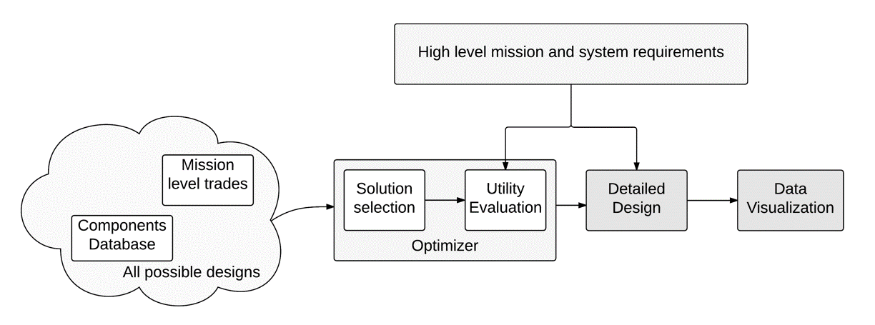
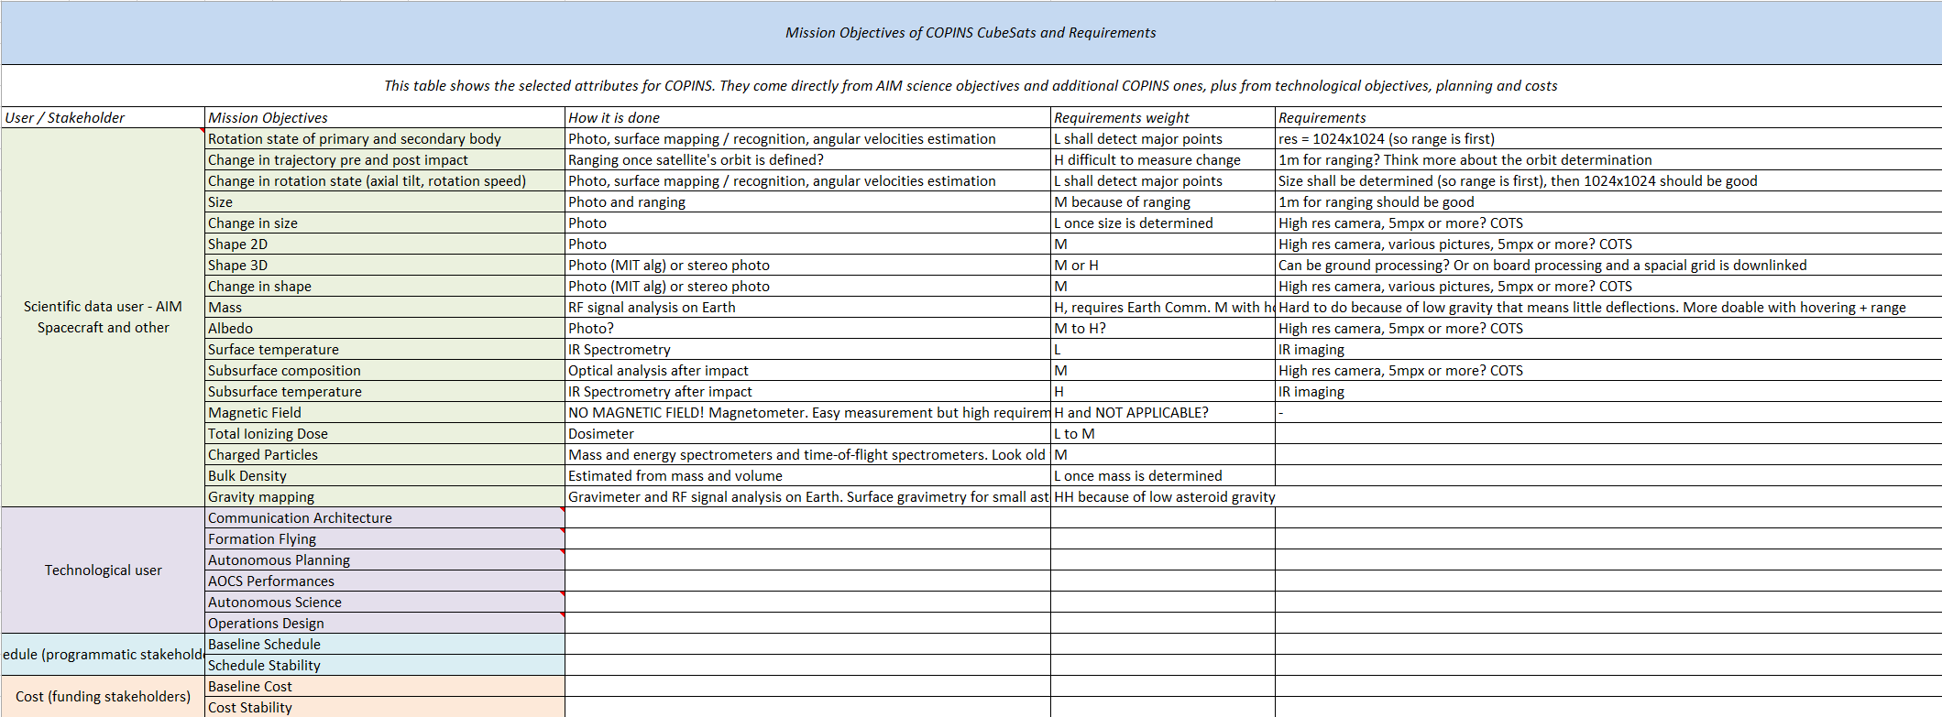
The Design Vector
How do we describe each solution? How can we include both mission and system level aspects in the solution?
Science traceability matrix
Input: STM
Output: DV and weights
Notes:
I started by creating a matrix for all the possible objectives for the CubeSats. I wanted to include both mission aspects and systems in the solution, so I started from the Science Traceability Matrix for the CubeSats mission. The objectives inserted into this matrix were considering the science objectives that the main spacecraft was pursuing (for support), additional science objectives not pursued by AIM, technological objectives and organization ones (cost, schedule, funding). For most of these, both instrument and mission requirements were defined.

Slide 18
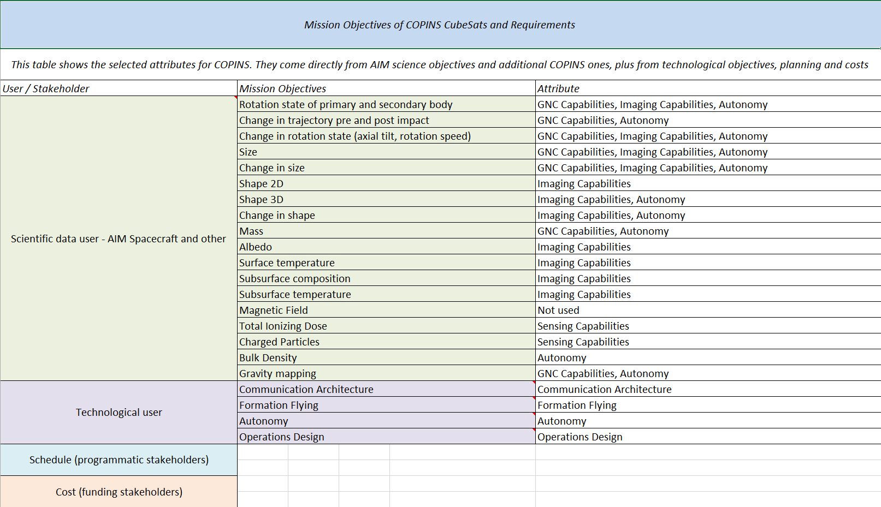
The Design Vector
From STM to the Design Vector
Science traceability matrix
Attributes definition
Input: STM
Each objective defines a sets of attributes that are involved
Output: DV and weights
Notes:
Once the list of objectives was selected, I identified which category each objective was influenced by. For example, let’s consider the CubeSat objective: to measure the change in size of the asteroid. This measurement can be performed by a CubeSat that is carrying a camera on board, by taking pictures. In addition, precise information on the distance from the asteroid is needed, and a few grades of processing on board are also necessary.
At the end, we can say that the objective of measuring the change in size is influenced by the imaging capabilities, the gnc capabilities and the grade of autonomy on board. This type of relation was constructed for most the objectives defined.

Slide 19
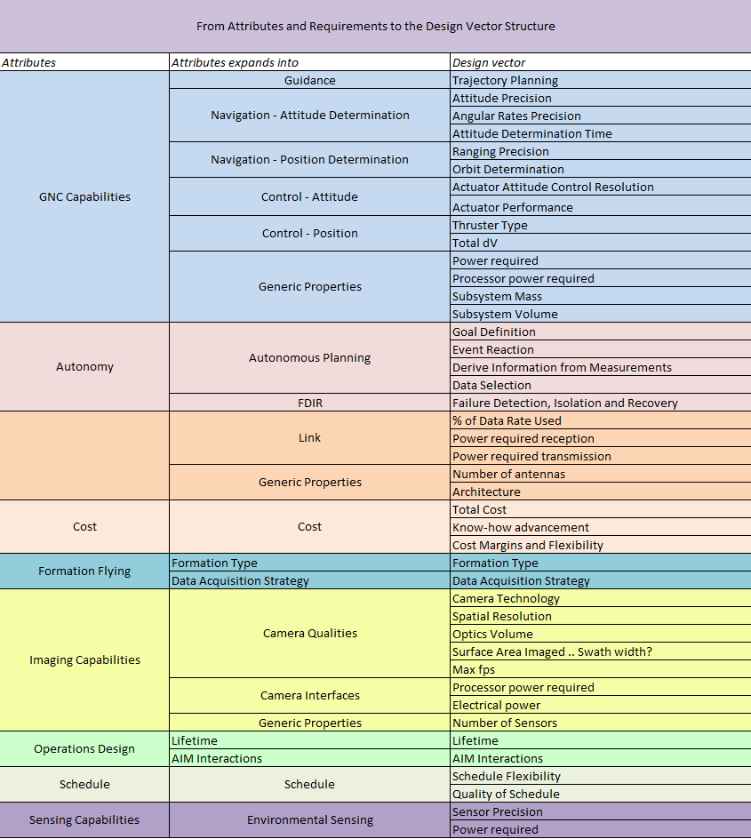
The Design Vector
From STM to the Design Vector
Science traceability matrix
Attributes definition
Expanding into the design vector
Input: STM
Each objective defines a sets of attributes that are involved
Each attribute expands into more detailed aspects
Output: DV and weights
Notes:
The following step has been to further expand these categories that I just defined. For example, the GNC capabilities category was expanded into Guidance, Navigation, Control and general properties, and further into elements like Attitude control precision, determination precision, thruster type, subsystem mass, power required, and so on.

Slide 20
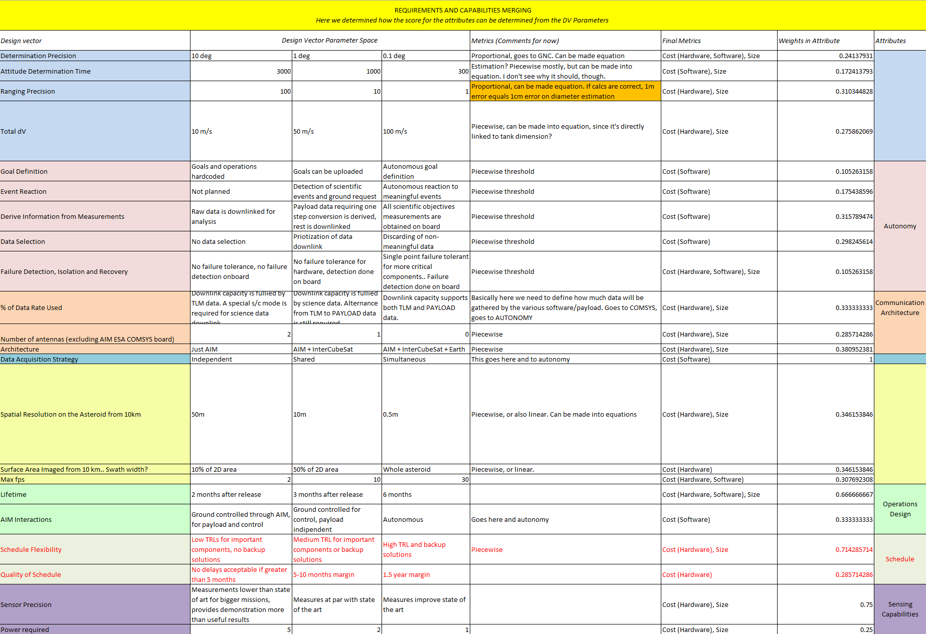
The Design Vector
From STM to the Design Vector
Science traceability matrix
Attributes definition
Expanding into the design vector
Input: STM
Each objective defines a sets of attributes that are involved
Each attribute expands into more detailed aspects
Attributes weights and metrics assessment
Output: DV and weights
Each of these aspects is ruled by a law, and this law influences the utility
Notes:
This list of parameters was then evaluated. I constructed a table where, for each parameter, I was able to identify either an equation or a piecewise evaluation, where the performances were graded wrt the stakeholder satisfaction. In addition, I was able to identify which type of final metric was influencing each of these attributes. This is done because, let’s remember, we are trying to come up with a way to assess the cost (or the size) for each solution. And each solution is governed by the attributes that we defined earlier.

Slide 21
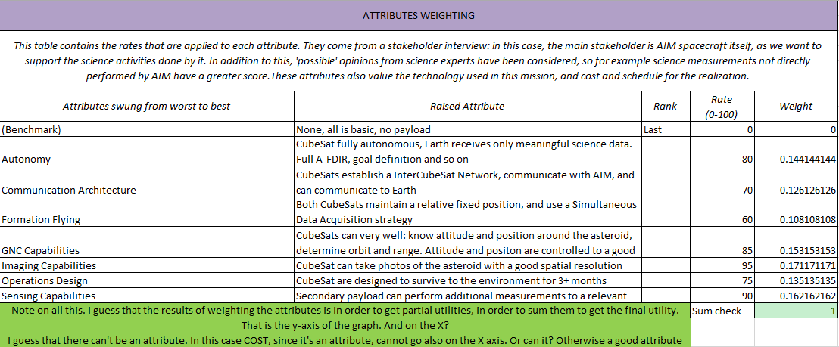
The Design Vector
From STM to the Design Vector
Science traceability matrix
Attributes definition
Expanding into the design vector
Input: STM
Each objective defines a sets of attributes that are involved
Each attribute expands into more detailed aspects
Attributes weights and metrics assessment
Output: DV and weights
Attributes evaluation
Each of these aspects is ruled by a law, and this law influences the utility
Finally, weights are applied to these aspects in order to obtain global utility
Notes:
Lastly, in order to define the utility function, all the macrocategories of the attributes (like GNC capabilities, for example) were weighted considering their influence on the final utility. We now have a set of attributes that map both to a specific parameter (cost and size) and that of which we can calculate the final utility.

Slide 22
The Design Vector
How is our solution shaped?
Total: 22 elements
Total solution space: 12+ billions
Field | Parameter # | Equipment
Autonomy | 5 | -
Communication | 3 | Radio
Imaging Payload | 2 | Camera
Secondary Payload | - | Any in DB
GNC | 4 | Thrusters, RW
Data Acquisition | 1 | -
Operations | 2 | -
Notes:
This is the table that sums up the design vector, with the number of parameters for each macro category, and (if any) which equipment were included in the vector. In total, we have 22 variables, and this sums up to a solution space of over 12 billion.

Slide 23
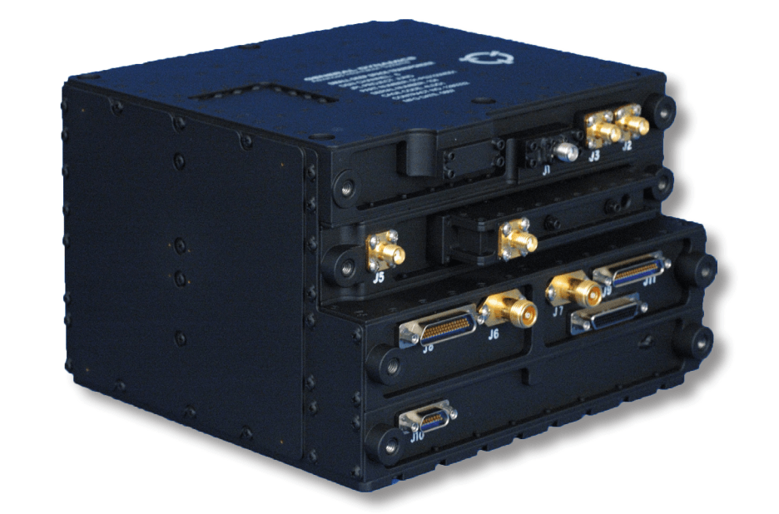
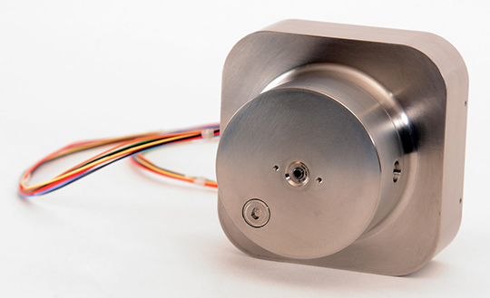
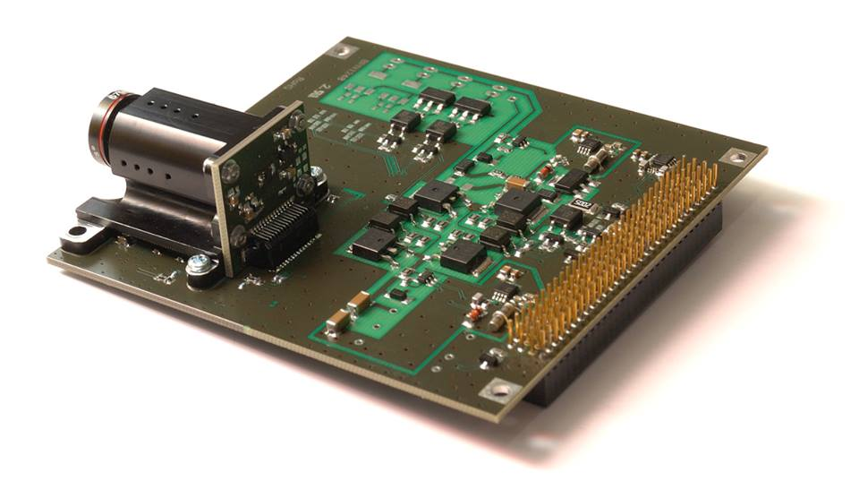
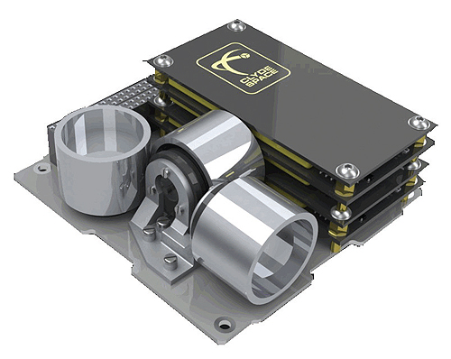
The Component Database
Defined in Matlab
Four mandatory parameters: mass, power, cost and size
Other parameters depending on the category
Compatible by design with the Small Satellite Database (JPL)
Notes:
Regarding the components database, the first version has been designed directly in matlab: each category of item can have different parameters, but four parameters are mandatory: mass, size, power and cost. Other parameters can be added, and are especially useful since they can be later compared to the requirements. The idea is to make it compatible with the small satellite database that we have been developing.

Slide 24

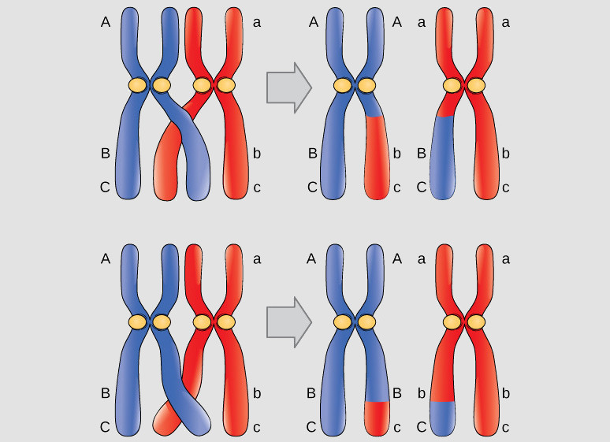
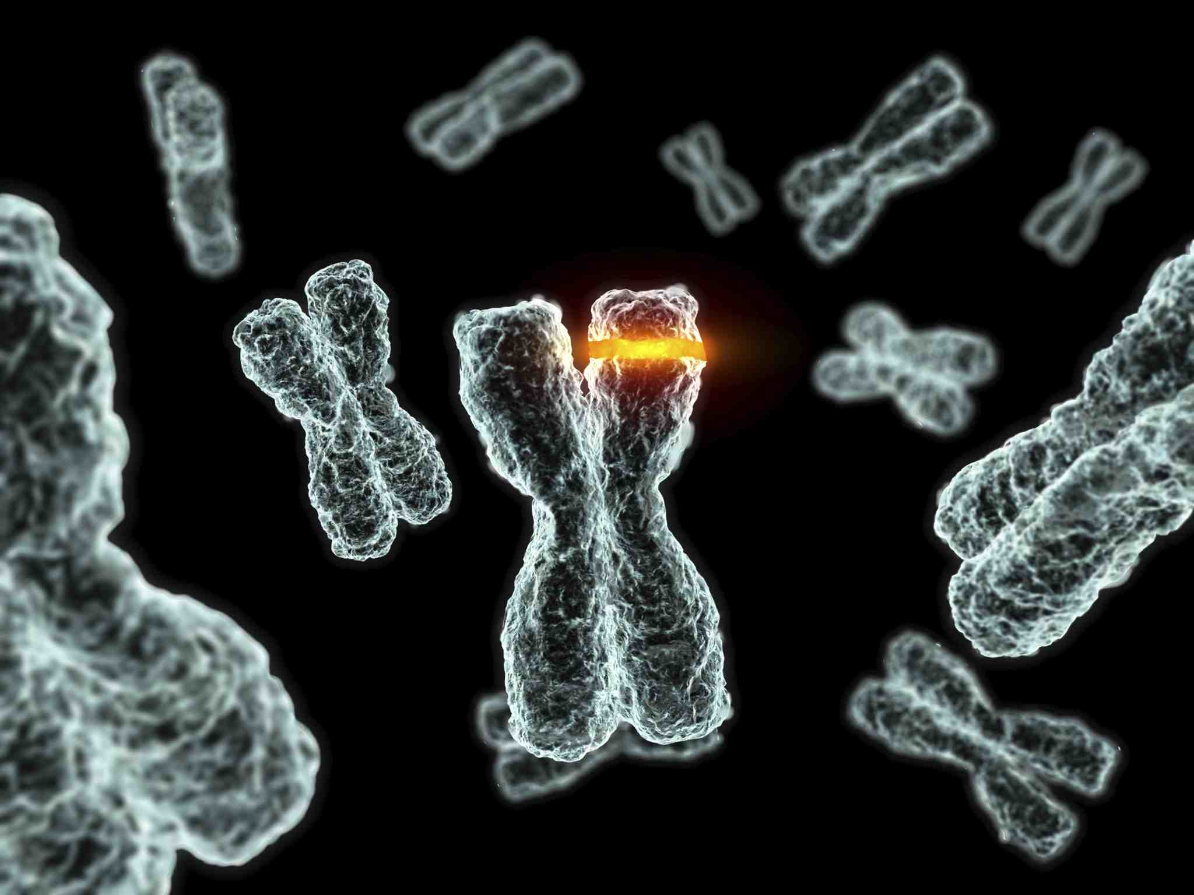
AI for Tradespace Exploration
Genetic Algorithms
Introducing a genetic algorithm to quickly explore all the possible design vectors
How it works
Emulates the behavior of living beings, especially the dynamics of population of individuals
Reproductive dynamics can be emulated by selecting the appropriate functions
Population initialization
Crossover
Mutation
Notes:
Before addressing the results, I would like to spend a few words on the optimizer I’ve used: a genetic algorithm. This type of algorithms is constructed to emulate the behaviour of living beings, especially the dynamics of populations. Functions like reproduction (with the crossover) or the mutations are also included.

Slide 25
AI for Tradespace Exploration II
Genetic Algorithms
Selected Characteristics
Individuals described by chromosomes of integer genes
22 gene dimension
12.3 billion individuals (solutions) explored
Custom creation, mutation and crossover functions were implemented
Initial population of 330
Simple crossover in a random point
Mutation rate 5%
Genetic Algorithm made of generational + elitism traits
Tournament selection
Elite population (15 individuals)
Infeasible solution
Violated requirements
Discarded and population re-initialized randomly for the remaining individuals
Stopping condition
Iteration number or tolerance threshold
Notes:
A brief overview on how the algorithm was setup.
As the design vector contained integers in each variable, I had to implement custom creation, mutation and crossover function for my population.
Initial population was set at 330 individuals, with a simple crossover and a mutation rate of 5%.
Tournament selection with elitism.
Infeasible solutions (those that violated the requirements) were discarded and the population was re-initialized randomly for the removed individuals

Slide 26
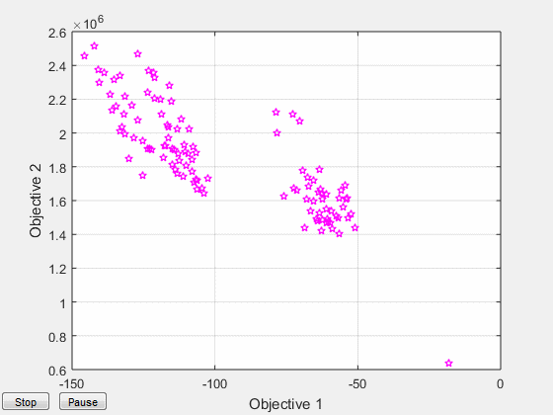
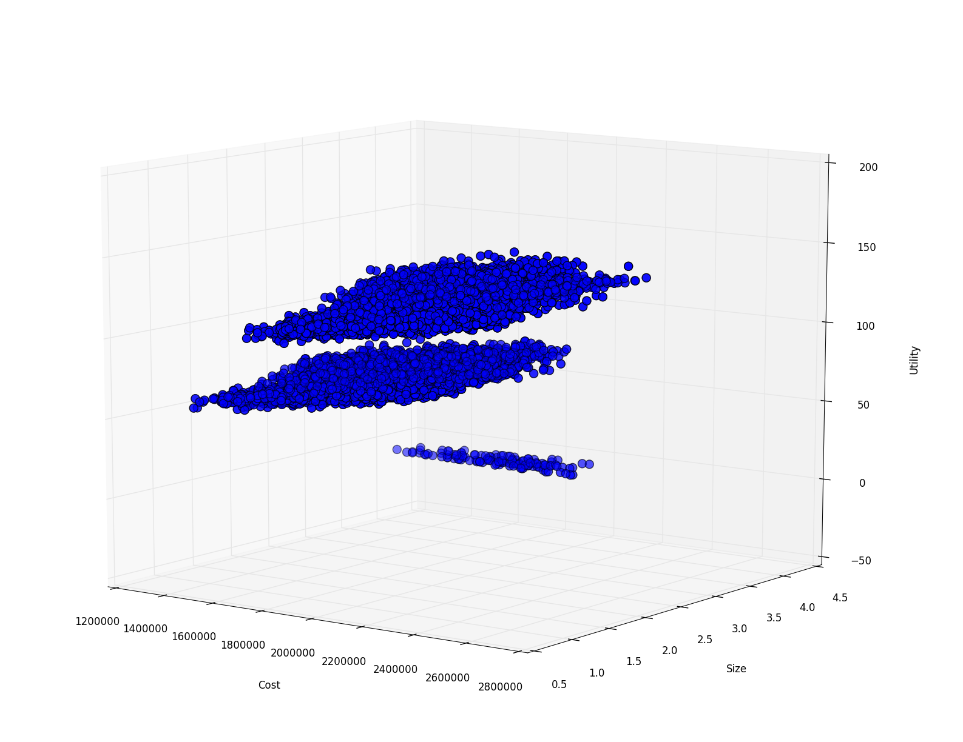
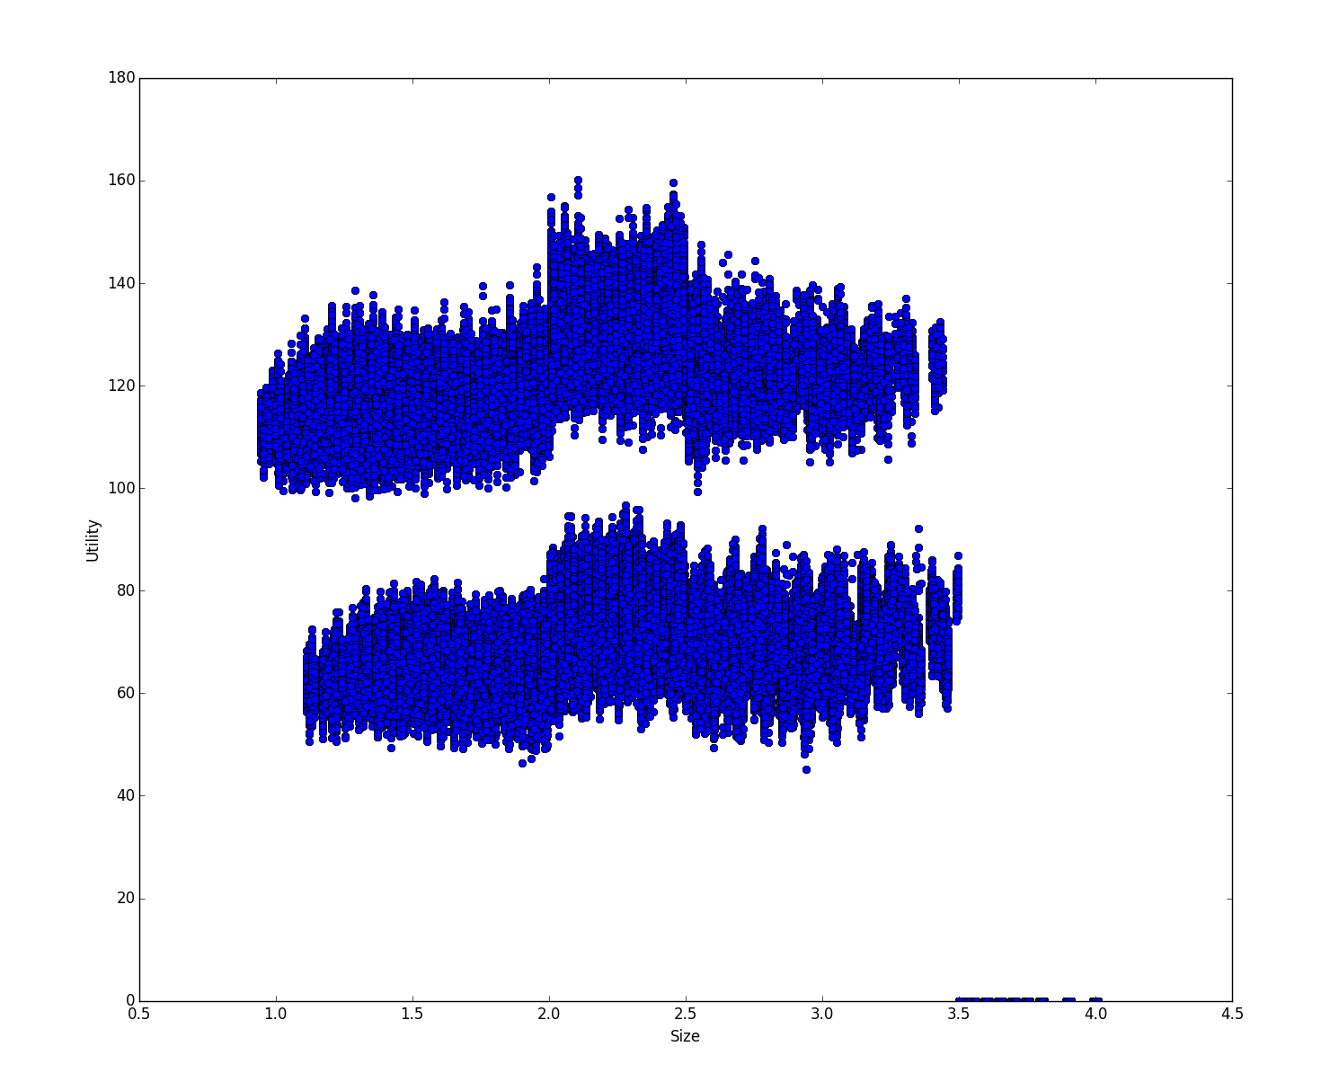
Solution space and Pareto front
22 elements design vector generates a huge space of possible solutions (12+ billions)
Genetic algorithm explores the solution space and converges to the optimal designs.
Downside:
This particular equation setup ‘confuses’ the algorithm, but results are still optimal
Optimization process: evolution in time of the population (image is tilted 90deg anti-clockwise)
Solution cloud (20k points): size, cost and utility are plotted
Solution cloud (1M points): size vs utility
Solution cloud (1M points): cost vs utility
Notes:
In this slide we can see the results of the optimization. First image shows the best individuals as the evolve towards the optimal solutions.
In the lower images you can see plots of the solution space. These plots represent less than the 0.1% of the solutions. It might be that the real solution space shape is different than this.

Slide 27
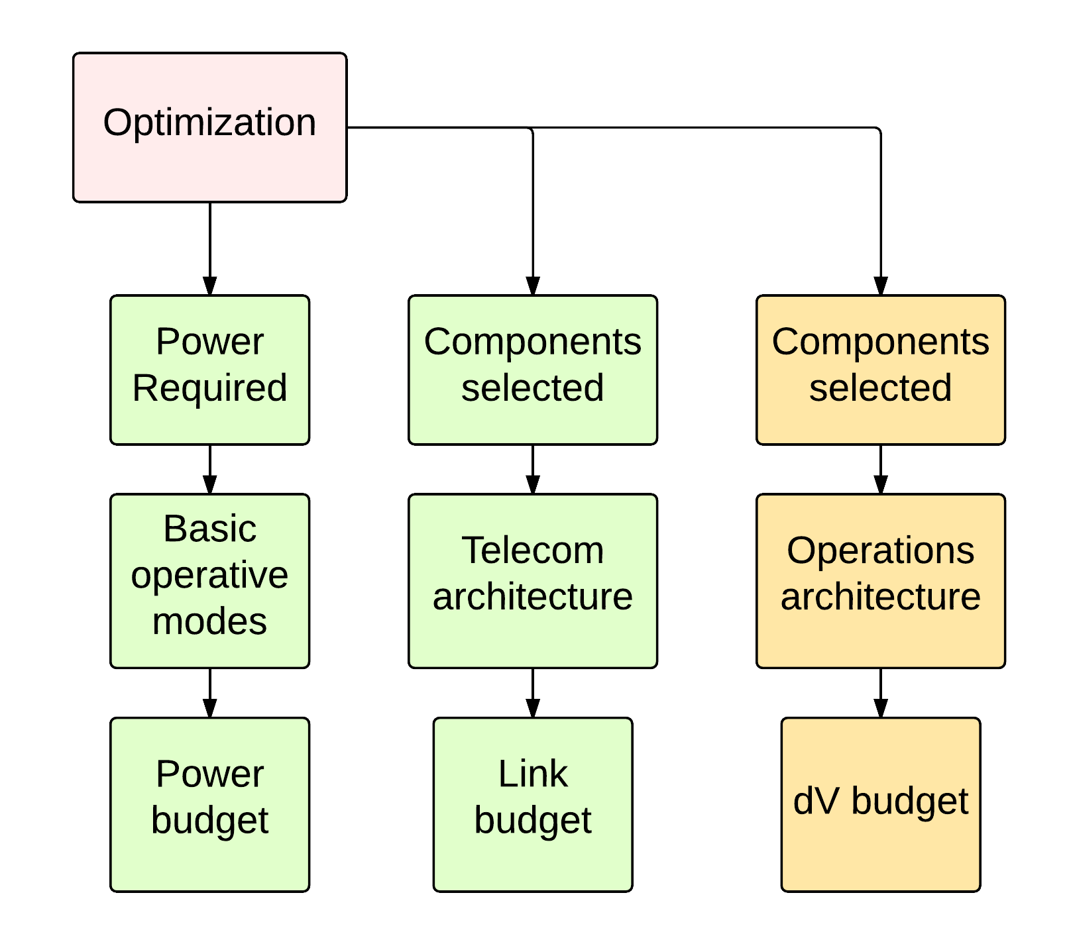
Completing the design I
Solution selection and budgets
Selection of the desired solution for detailed visualization
By utility value, by cost, by size or by power
Design budgets have
been implemented
Notes:
Additional data is provided at the end of a design session.
After the optimization has finished, the user can select the solution he wants to explore by visualizing the value range in four categories: utility, cost, size or power.
Once that is done, detailed system budgets have been implemented and can be visualized. By considering the chosen components and basic operative modes (of which the user can specify the duty cycle) the power budget is calculated. In addition, solar panel and battery sizing is performed.
Similar reasoning is done with the comsys, after the components are considered (and the mission requirements evaluated, especially regarding range and desired data rate) the link budget can be defined.
In addition, this can be also done for the propulsion system, but it hasn’t been implemented yet.

Slide 28
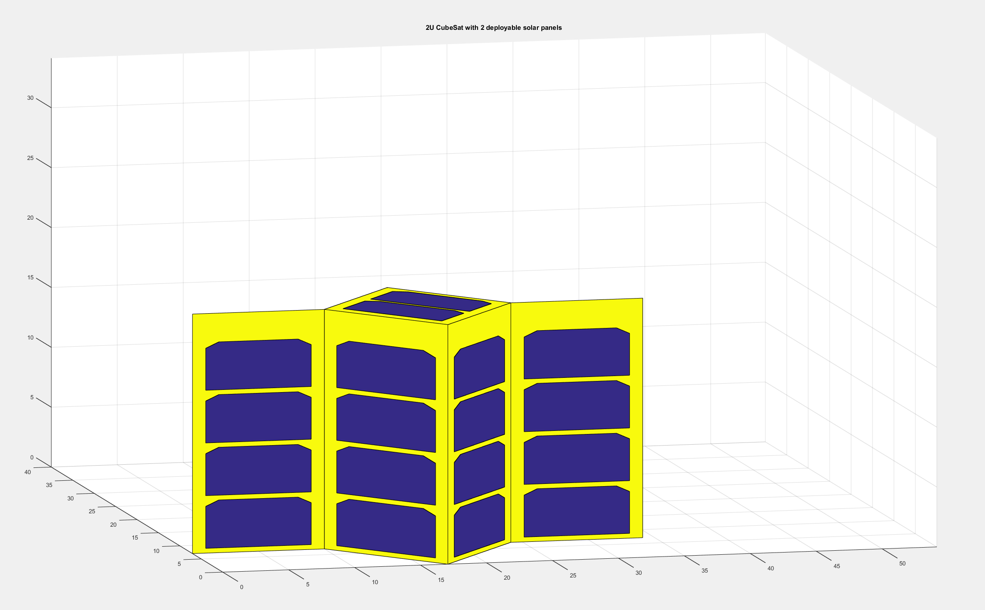
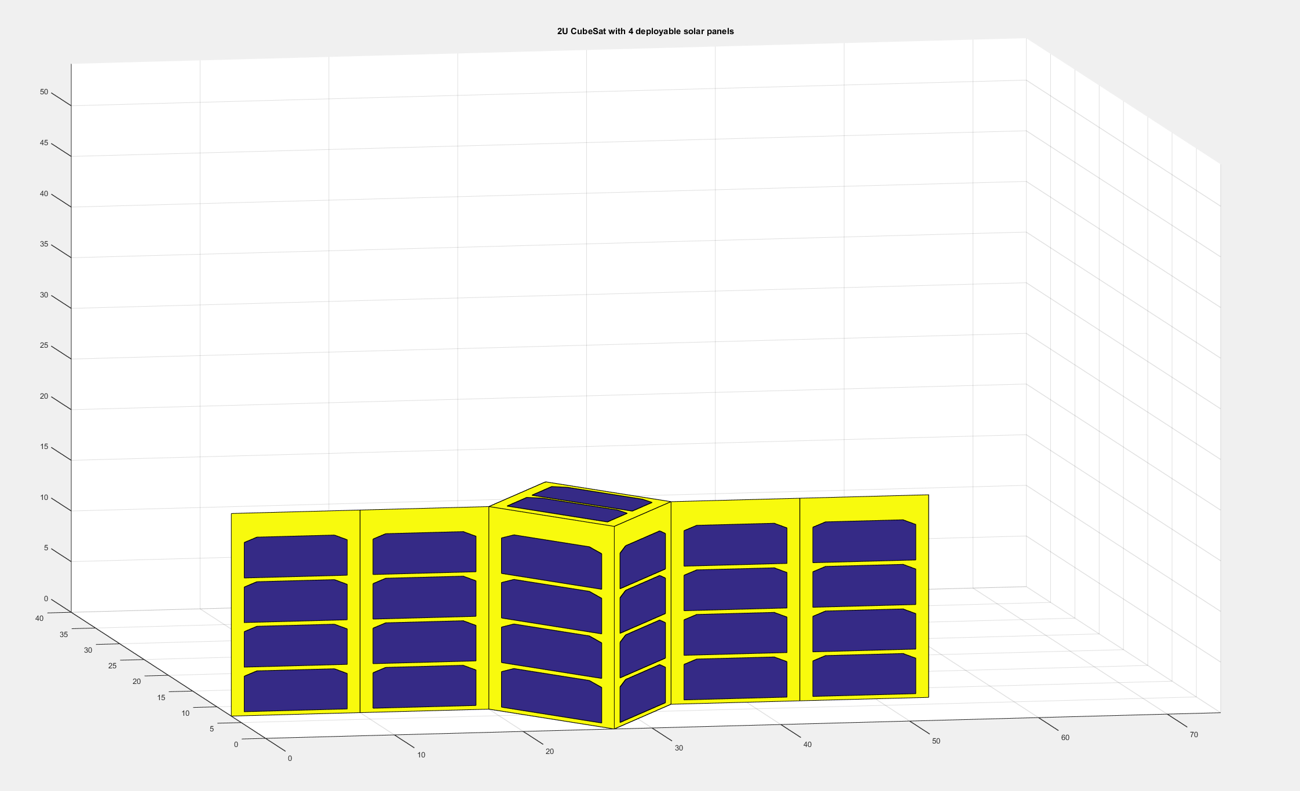
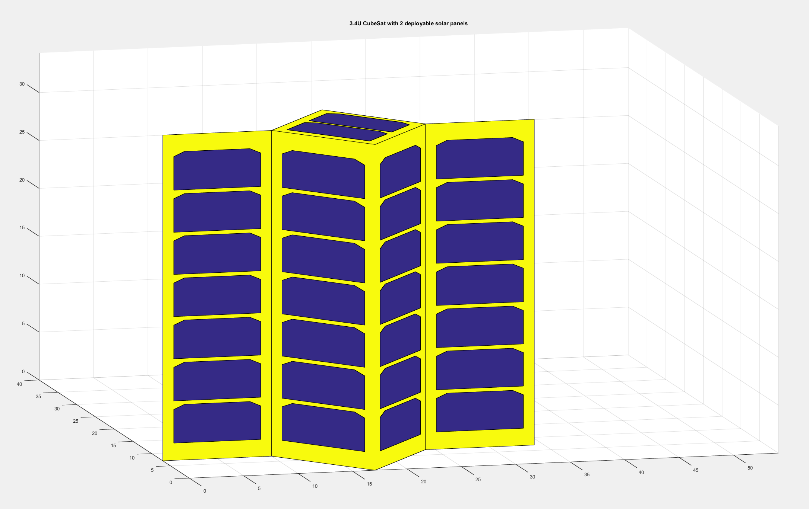
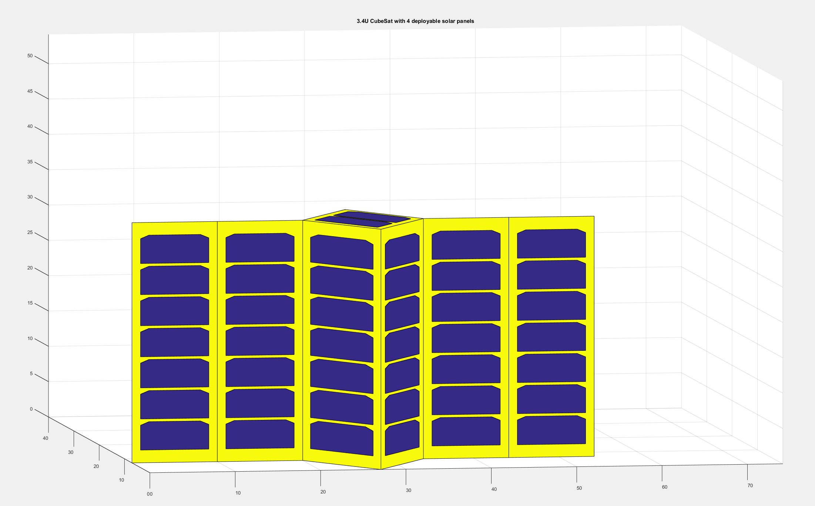
Completing the design II
Configurations - EPS
Power budget is defined once a solution is chosen
Takes into account basic operative modes
Power requirements of all the components
Solar panels sizing and batteries sizing are performed considering the defined power budget and the mission requirements
Solar panels configuration is automatically displayed once the power budget and the sizing is completed
Solar panels configuration: example outputs
Notes:
Continuing on the power budget, the tool provides also the visualization of the solar panel configuration, by matching the required cell number with any of the available configurations. For now, all the configs from 1U to 3U+, with zero to four deployable solar panels have been implemented.

Slide 29
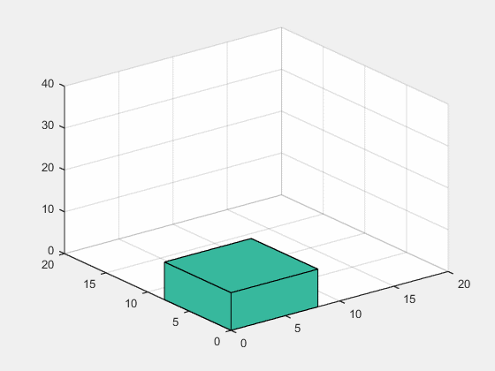
Completing the design III
Configurations – Internal arrangement
The tool allows to visualize the CubeSat internal structure
The boards are represented as parallelepipeds
Algorithm has been developed that tries to assemble the satellite to avoid empty spaces
Takes into account the mounting method (stacked or lateral)
Requirements for equipment positions are applied
It is possible to specify whether an item needs to be located close to an external surface
Optimization output: 3U CubeSat with camera payload
Notes:
Finally, let’s take a look at the internal configuration. As you can see in the image, an algorithm for the assembly of the cubesat stack has been developed. The algorithm will try and assemble the cubesat in a specified way (in this case, stacking the items from the top), avoiding the empty spaces when possible. Requirements for item position can be defined as well (for example, if a camera needs to have its optics facing a specific face of the cubesat).
The specification of these requirements is done at the database level.

Slide 30
Autonomy
Neural networks for image classification
Notes:
This concludes the first project I’ve worked on during my period here. In addition, I pursued my research interest in the autonomy field, focusing on autonomy enhancing technologies that can be applied to small satellites.

Slide 31
Payload data selection - Objectives
Use neural networks to implement algorithms that can be applied in the COPINS case study
High level image quality assessment
Event recognition
Necessary activities:
Define the architecture of the network
Prepare the training/testing sets
Prepare the work for future performance evaluation
These algorithms will be evaluated on an embedded processor
Final objective is to construct a Hardware-in-the-Loop simulation with an optical payload
Notes:
On the field of the autonomy, to this mission I’ve researched on two algorithms that can be applied. One is the payload data selection (and in this case theimage quality assessment) and event recognition.
As a technology, I’ve developed the algorithms considering neural networks. The idea behind this work was to prepare for future algorithms performance evaluation, both on a workstation and on an embedded processor. Lastly, the final objective will be to construct a hardware in the loop simulation with an optical payload. This means having a camera connected to our onboard computer, taking fake asteroid pictures and deciding whether to keep them or discard them.

Slide 32
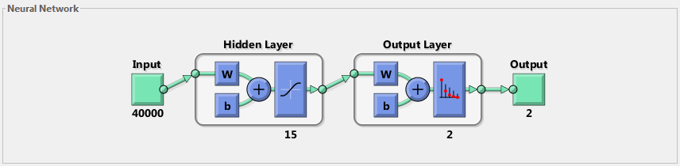
Network Architecture
Originated by emulating biological neurons
Useful for pattern recognition, data classification
Needs to be trained
When properly trained, shows good degrees of robustness and adaptivity
Network architecture for event recognition problem
Notes:
Let’s take a look at what are neural networks in the field of computational biology. They are a type of algorithm that tries to emulate sets of biological neurons, emulating their behaviour. They are usually constructed by creating sets of computational units called neurons, and applying them into layers.
They are useful for pattern recognition and data classification.
As the human brain, also this type of network needs to be trained, but when they have been properly trained these types of algorithms show good degrees of robustness and adaptivity.
In the image we can see the typical network architecture I was using during this problem.

Slide 33
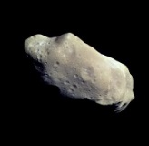
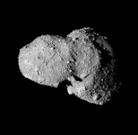
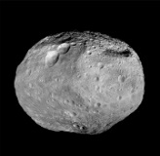
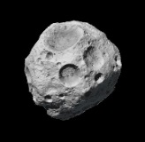



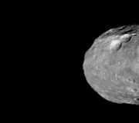
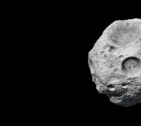
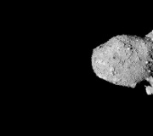
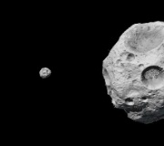
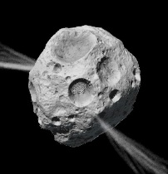
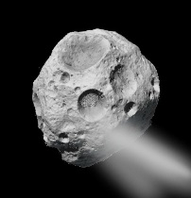
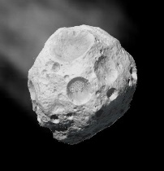
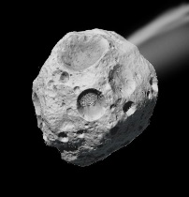
Activity – Payload data selection
COPINS
Neural networks for image recognition
Network trained on asteroid pictures
Tested with different types of asteroid pictures to assess robustness
Backpropagation method
Different architectures explored
Varying the number of neurons, the random range for weights init, learning coefficient, and so on
Different image quality (from 50x50 pixels to 512x512)
Concept of operations is taken into account for training
Algorithm trained to:
Discard low quality photos
Detect random events (plumes appearing, for example)
Training subsets examples: asteroid centered, out of focus image, non centered image, plumes
Notes:
For designing the algorithm for image recognition I’ve created the network and trained it on asteroid pictures. The network was trained using the backpropagation algorithm.
In the end the algorithm was trained to discard low quality photos and detect random (and not predictable events. As for example plumes coming out of an asteroid/comet.

Slide 34
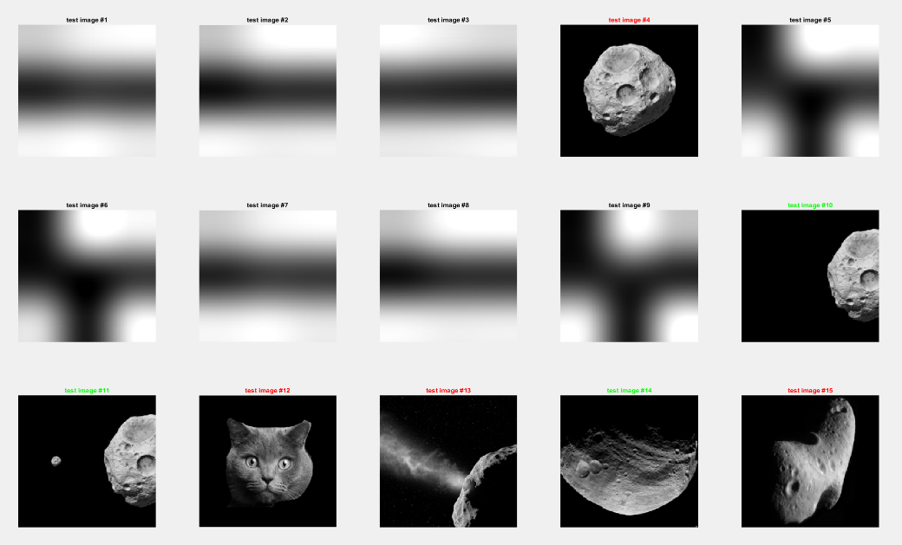
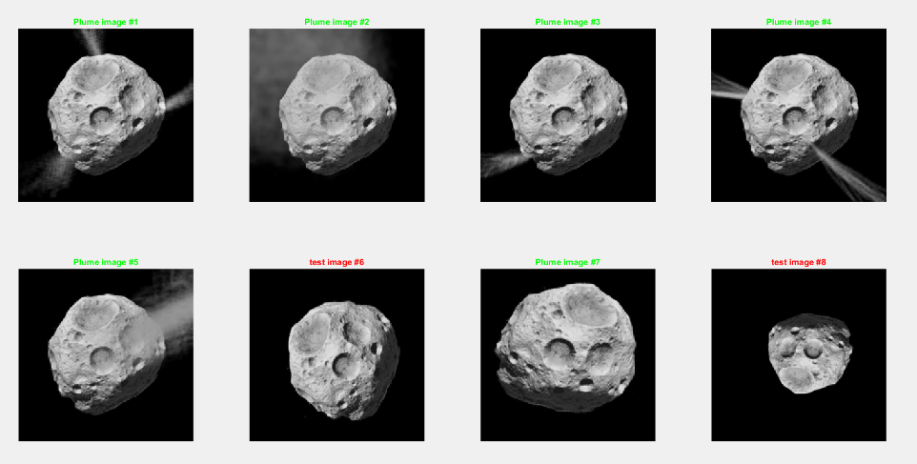
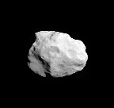
Results obtained – Payload data selection
Different problems were analyzed:
Data selection
Event recognition
The proposed algorithm is sufficiently robust to be used for both the cases, and the results are satisfying.
Improvement can be made by better tuning the network architecture, or by increasing the number of training images.
Images shown in red are interesting because they show particular behavior of the algorithm
Asteroid photo selection
Plume detection
Notes:
In this image we can see the results of this algorithm, when applied to different asteroid pictures. In the left image we can see how the two different classes of images (centered and non centered, high quality) and not focused images we correctly identified in the proper category. In the right image, we can see how each image that was showing at least one plume in it was correctly identified. The two orange boxes represent false positive images that are probably due to the small size of the training samples.

Slide 35
Autonomy
Fuzzy logics for failure detection
Notes:
This concludes the first project I’ve worked on during my period here. In addition, I pursued my research interest in the autonomy field, focusing on autonomy enhancing technologies that can be applied to small satellites.

Slide 36
Activity – Failure Detection
Autonomous failure detection by means of fuzzy logics
Magnetic torquers failure modeling (clockwise, starting top left): float, lock-in-place, hard-over, loss of efficiency
Definition of fuzzy input and output variables on Matlab: current, d-current, dd-current, error, estimated Loss of Efficiency
RuleViewer for the failure detection: each failure mode has specific traits in the characteristics of the monitored variables. Specific rules have been defined to categorize the failures.
Integration of the FDIR algorithms in the simulations of a 3U CubeSat for GNSS Remote Sensing
Notes:
Continuing, let’s take now a look at the failure detection isolation and recovery algorithm. This type of algorithm is set up to detect failures happening to actuators on the system. For now I’ve considered as actuators the magnetic torquers, even though they surely won’t be present in a cubesat asteroid mission (but they probably will in a LEO mission) and the idea is to extend this algorithm to other types of sensor later.
As we can see in the top left image, these are the four typical failure modes of a magnetic torquer: we are looking at the current flowing inside the MT. When the torquers locks in zero output, when the output is constant and different than zero, when the efficiency of the output is reduced, and when the output assumes the shape of a slope.
I’ve built my algorithm using fuzzy logics, and inserted this algorithm in a 3U cubesat simulation that me and my colleagues developed in Italy the last year.

Slide 37
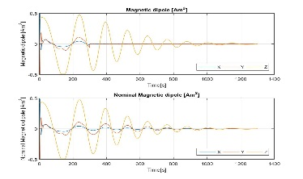







Results obtained - Failure Detection
Algorithm is verified: all the failures are correctly detected.
Most difficult to detect is the Loss of Efficiency (due to intrinsic behaviors of the failure), but simple filters allow for a stable identification
Failure detection: four different types of failure are activated in a sequence. Instabilities are due to the fact that sometimes controller command is equal to the failed value.
Algorithm has been tested in the 3STAR CubeSat simulation, developing a fault tolerant attitude control solution
Simulation of the Attitude Control System with failure modes for the Magnetic Torquers
Notes:
This slides shows the results obtained. In the simulation I was injecting each failure after a constant amount of time. The image shows the results of the detection algorithm, and going from left to right we can see how the raw detection is already performing well, and how a simple filtering algorithm is used to remove the instability.
In the lower image, we see the results of the attitude control problem with a failed torquer on the X axis. Only in the case of the hard-over failure (that is the one where the current has the shape of a slope) the control algorithm was not able to recover the situation.

Slide 38
Inflatable Antenna

Slide 39





Inflatable Antenna
Characterizations test for the inflatable antenna prototype
Allows to study different configuration of the inflatable antenna on a CubeSat
1U to 6U are supported
Antenna diameters from 0.5m to 4m
Calculates predicted gains, intertias and volumes
Allows to specify a filling gas
Modeling of the inflatable antenna on MSC Adams
Preparation for the future Small Satellite Dynamic Test-bed tests
Notes:
Finally these are the two secondary projects I’ve worked on during this time here. The inflatable antenna project, led by Alessandra, where I’ve helped with the initial characterization tests at the MESA, I’ve develped an excel spreadsheet to perform a system engineering analysis of the antenna when deployed from a cubesat, and I’ve modeled the dynamic behaviour of the antenna in MSC Adams software.

Slide 40
Small Satellite Mission
Database

Slide 41




Small Satellite Database
Notes:
Lastly this is the small satellite mission database.

Slide 43





Environment
COPINS mission
Understanding the environment
Simple cases
Stopping from a release of 2m/s
Hohmann transfer from 10km to 5km and 2km
Solar Radiation Pressure effects
Third body problem applies
Calculations on excel, verification on STK
Reference concept of operations
STK simulations: release, Hohmann transfer, 10km orbit, 1km unstable orbit

